Slide 1
Contemporary Tourism
Tourism in the Twenty First Century

Slide 2
Lecture Objectives
Be able to appreciate some of the key factors influencing tourism
Understand why the condition of the physical environment is significant for the future of tourism
Understand the potential significance of climate change for tourism environments and destinations
Identify some of the difficulties associated with predicting tourist flows and patterns
Appreciate the role that aviation plays with respect to both climate change and energy supply issues in tourism
Appreciate the value of scenarios as a decision-making tool

Slide 3
An Uncertain World
The future is unknown
Prediction is difficult due to:
Wild card events, e.g., COVID-19
Shifting business environment
All elements impact upon the production and consumption of tourism whether directly or indirectly

Slide 4
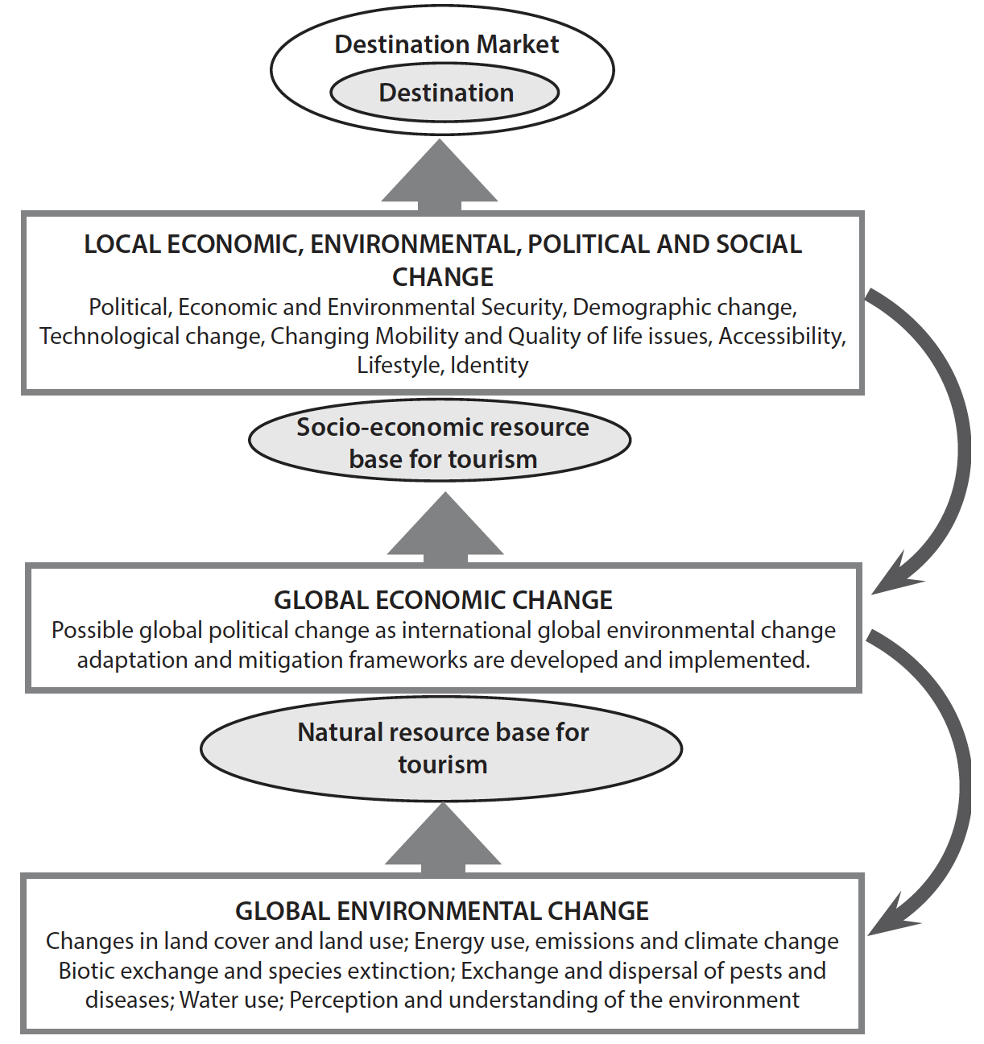
Trends and issues affecting contemporary tourism

Slide 5
Paradox
Growth in international tourism, i.e., forecasts for 2020 and 2030, set against global environmental change and the effects of COVID-19
Paradox – can they be reconciled, especially global environmental change?
Forecasts versus concerns
  Political instability
  Energy costs
  Global environmental change

Slide 6
Climate Change
Major issues for
  Coral reef tourism
  Coastal tourism
  Winter tourism
  Other areas just as important but do not received as much coverage, e.g. biodiversity
Responding to change
  Greenhouse Gasses (GHG)
  Aviation sector, as a major source of GHG, and with aviation fuel hard to substitute

Slide 7
Climate change
Efficiency gains not as great as increase in tourism.
  Absolute emissions from tourism continue to increase even though may be lower on a per trip or per passenger/km basis.
Aviation and shipping not included in the Paris 2015 agreement
Even with the Paris agreement global warming and sea level rise will be substantial. What will be the effect of further measures on tourism?

Slide 8
Predicting Change
Causality difficult to determine
Difficulties in predicting tourist or business behaviour

Slide 9
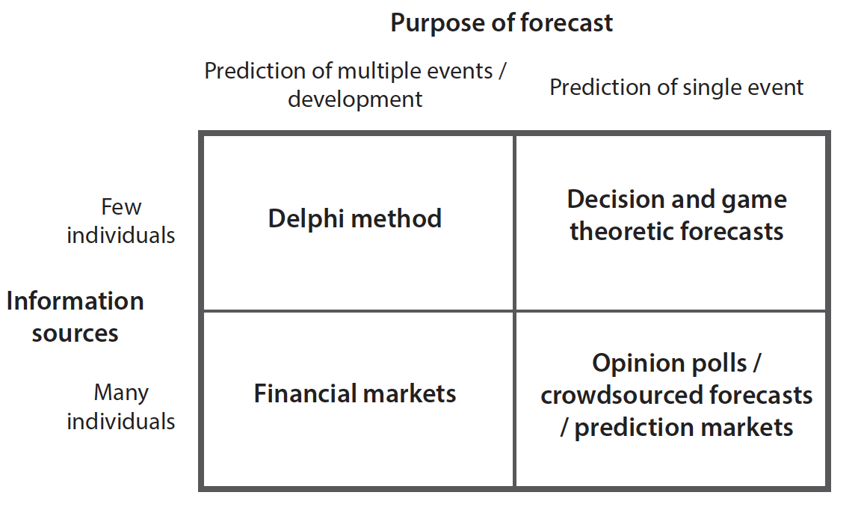
Examples of forecasting approaches

Slide 10
Tourism, oil and peak carbon
Tourism transport, especially aviation, highly dependent on oil – difficulties in substitution
Although substantial fluctuations in prices long-term trend is for oil to become more expensive although it will always be available (at a price)
Short-term concerns over cost of oil
Long-term concerns over peak carbon rather than peak oil given emission limits

Slide 11
Transition Management
Long-term thinking (at least 25 years) as a framework for shaping short-term policy.
Thinking in terms of more than one domain (multi-domain) and different actors (multi-actor) at different scale levels (multi-level).
Focus on learning and philosophy (learning-by-doing and doing-by-learning).
System innovation alongside system improvement.
Keeping a large number of options open (wide playing field).

Slide 12
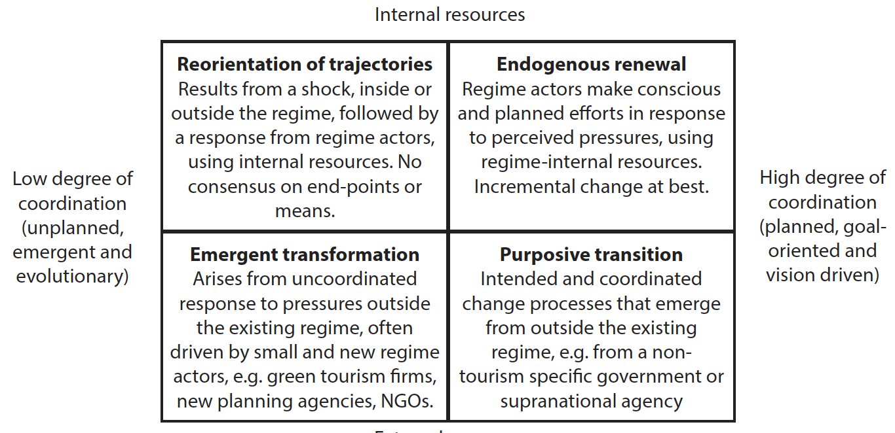
A typology of transitions

Slide 13
Approaches to growth crisis
A business as usual (BAU) approach which may intensify existing market-oriented approaches to the problem of growth.
A ‘green growth’ approach which still utilizes quantitative notions of output, but which puts a strong focus on technological solutions and greater efficiency in MRE use.
A degrowth approach that seeks to integrate efficiency and sufficiency approaches.

Slide 14
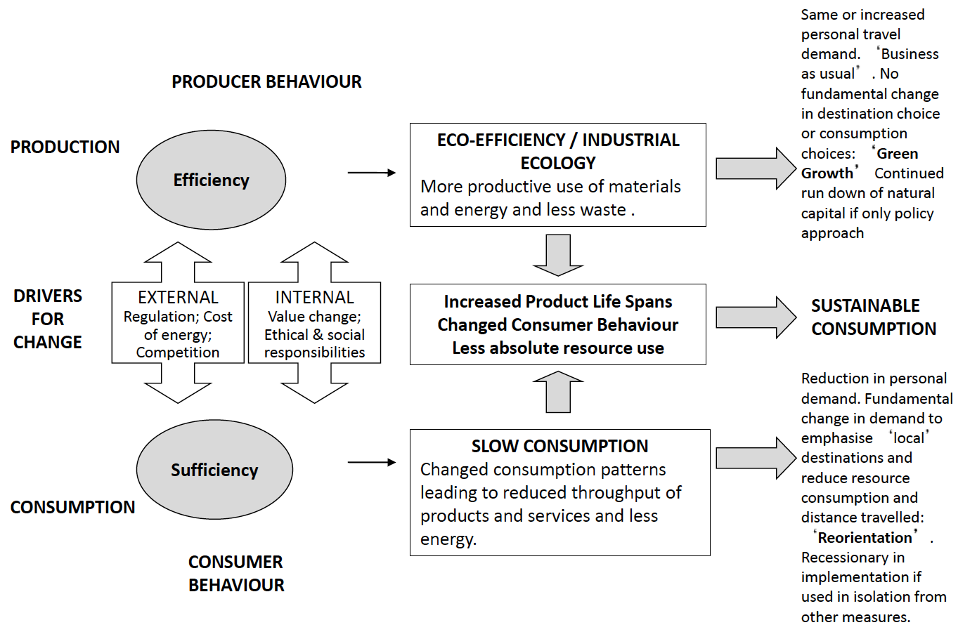
Efficiency, sufficiency and sustainable tourism consumption

Slide 15
Sustainable Development Goals (SDGs)
The UN 2030 Agenda for Sustainable Development, adopted at the 70th UN General Assembly in September 2015, set a series of 17 Sustainable Development Goals (SDGs)
“to end poverty, protect the planet and ensure prosperity for all ...[by 2030]... as part of a new sustainable development agenda”.

Slide 16
SDGs
The 17 SDGs underpinning the 2030 agenda for sustainable development have 169 associated targets, which cover all aspects of sustainability:
to end poverty,
promote prosperity and well-being for all, and
to protect the planet.

Slide 17
SDGs
UNWTO & UNDP (2017) suggests that tourism can play an important role in the pursuit of goals:
8 (Inclusive and sustainable economic growth),
12 (Sustainable consumptionnand production), and
14 (Sustainable use of oceans and marine resources).

Slide 18
Summary of Key Points
Change in tourism is normal
Technological change will be a dominant force along with environmental conditions and concerns over sustainability
The disruptive capacity of new services is dependent on the regulatory environment
The consumer and the supplier of tourism remain interdependent

